Slide 1










MINISTRY OF HIGHER EDUCATION AND SCIENTIFIC RESEARCH​
Web application for bakeries management
&
Mobile application for bakeries finder and passing orders
Realized by
Ibtissem CHALBI​
Directed by
Anis BEN BETTAIEB
25 June 2019
Academic year
2018/2019

Slide 2




Table of content
05
Conception
03
Solution
01
Introduction
07
Conclusion
&
Perspectives
?
02
Problematic
06
Implementation
04
Requirements
Notes:
i ll begin by mentioning the plan used to make this project ,
Starting by a brief introduction, followed by the presentation of the company where the internship took place, passing over to the Problematic and the solution for it.
Than i will move on to the requirements and the realization
, finally i will finish this presentation with a conclusion and some perspectives

Slide 3
Introduction
Notes:
Following the previous plan i will be starting by the introduction

Slide 4


Introduction
Bakeries
Clients
4
Notes:
Le lien entre les patisseries et les consommateurs n’a jamais été coupé,
les patisseries étant l’un des plus importants établissements de restauration.
Ils sont vraiment demandés, pour la plupart des evenements, car ils vous permettent d’exprimer votre créativité,

Slide 5
?
Problematic
?
?
Notes:
So what is the problem here?

Slide 6



Problematic
Analysis of the existing
Social media
Google map
Yelp
Notes:
Je vous presnete 3 solutions existants
Réseaux sociaux

Slide 7
Problematic
Criticism of the existing solutions
Social media
Google map
Yelp
Time consuming.
Risk of being wrongly informed about the place.
No information about the prices.
No security in passing orders.
Places are added by anyone not the owner.
The suggestion are only based on the location of the user.
No on-line orders.
Not enough information about the products.
The site is designed only for reviews. Can not pass an order.
Too many types of business.
Not available worldwide.
7
Notes:
*Le problème qui doit être souligné est le fait que les réseaux sociaux prennent beaucoup de temps et qu’ils ne sont pas toujours fiables
*Google map a également montré quelques points faibles, les pâtisseries qui y sont trouvées sont ajoutées par les utilisateurs et non pas le propriétaire de la pâtisserie lui-même
*Yelp est un site web et application mobile qui est destiné pour les commentaires et n’est pas disponible en Tunisie.

Slide 8

Solution
Notes:
The problematic opens doors to the proposed solution

Slide 9


Solution
Cake it up
Mobile
Web
Pass orders
Find pastries/Bakeries
Help other customers
Get more details about a pastry
Manage pastries
Cake it up
9
Notes:
Notre solution est une application web pour la gestion des patisseries
Et une application mobile pour la gestion des commandes

Slide 10

Requirements
Notes:
besoins

Slide 11

Requirements
Actors
Administrator
Pastry owner
Client
11
Notes:
L’application posséde 3 acteurs
proprietaire

Slide 12
Requirements
Functional requirements
Administrator
Connect into his private space of the application
Manage reports
View statistics
Activate/deactivate pastries
Block clients
Manage account
Receive notifications.
12
Notes:
For the Administrator he wants to be able to

Slide 13
Requirements
Functional requirements
Pastry owner
Create an account
Connect
Manage his shop
Manage complains received from the clients
Manage orders
View statistics
Manage his own products
Manage personal events
Receive notifications.
13
Notes:
The application have to fulfill a number of requirements for the pastry owner as well such as

Slide 14
Requirements
Functional requirements
Visitor
Client
Customer
he can manage his account
Manage orders
Create complains
Manage cart
Add reviews
Create a personal order
Report a Bakery
Access to history of orders
Receive notifications
and rate a pastry shop
The ability to create an account
To connect
Manage cart
Consult pastries and products.
14
Notes:
Actually the client can be either a customer or a visitor:
The Visitor wants to be able to :
As for the customer he need to have access to his account ….

Slide 15

Requirements
Non-functional requirements
Security
Performance
Reliability
Maintainability
Availability
15
Notes:
Sécurité: chaque compte est sécurisé par un email et un mot de passe
Performance: réponse rapide
Fiabilité: tolérance aux pannes
Maintenabilité: facile à mainteneur et à faire évoluer
disponibilité: il peut être utilisé n'importe où et n'importequand

Slide 16
Conception
Notes:
As for the conception, I will present the use case and the class diagrams

Slide 17

Conception
Use case diagram: Web
Manage account
Manage the pastry’s clients
Manage pastry
Administrator
Manage pastries
<<include>>
<<include>>
<<include>>
Manage orders
Manage reports
<<include>>
Authentication
Manage products
Authentication
Response to complains
<<include>>
Manage clients
<<include>>
Pastry owner
Pastry owner
Manage account
View statistics
Manage personal events
17
Notes:
Starting by the use case diagram of the web application

Slide 18

Conception
Use case diagram: Mobile
Manage account
Like/Dislike pastry
Register
Visitor
Manage complains
<<include>>
View reviews
Rate pastry
View pastries
View history of activities
Authentication
Consult list of orders
View products
Consult notifications
Search
Customer
Report pastries
Manage cart
Manage personal orders
18
Notes:
For the mobile application I provided this use case diagram

Slide 19
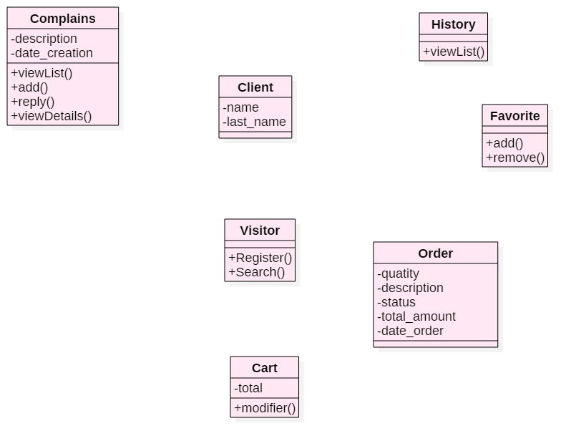
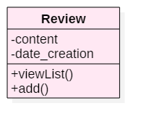
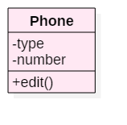
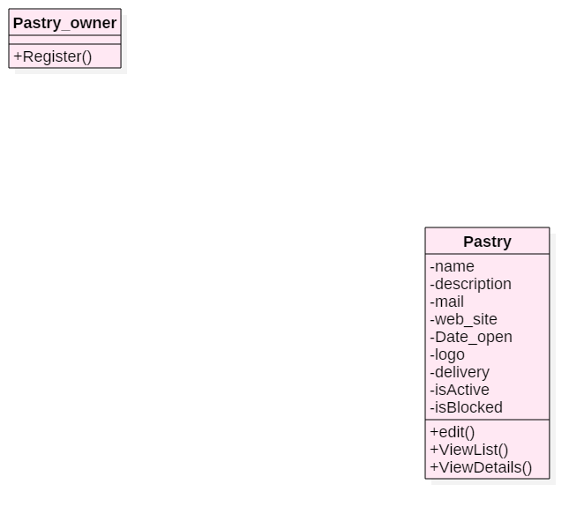
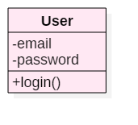
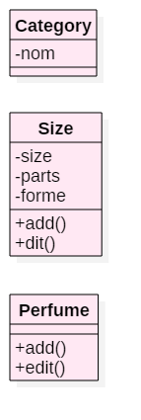
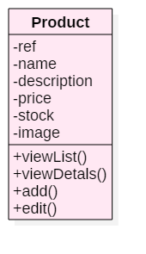
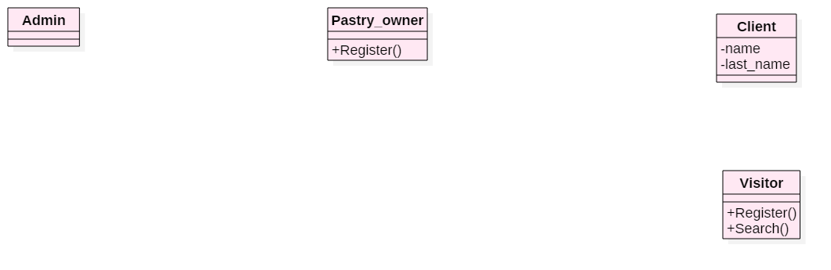
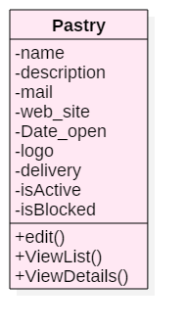
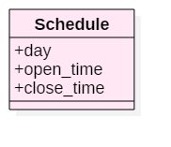
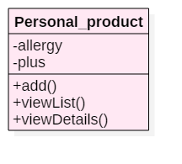
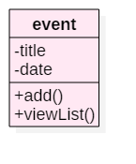
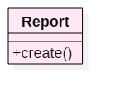
Conception
Class diagram
0..*
0..*
1
1
0..*
1
1
1
1
1
1
0..*
0..*
1
0..*
1
1
1
0..*
1
1
1
1
0..*
0..*
7
1
0..*
1
0..*
19
Notes:
The class diagram is really important for this application, it is the link between both the web and the mobile app

Slide 20

Implementation
Notes:
The implementation of the application is a critical part

Slide 21
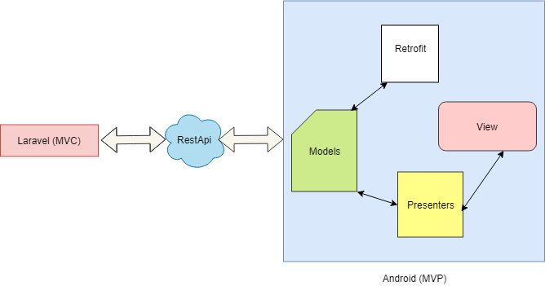
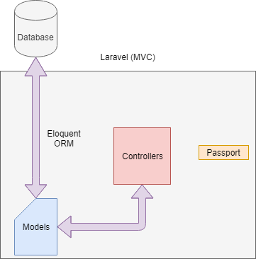
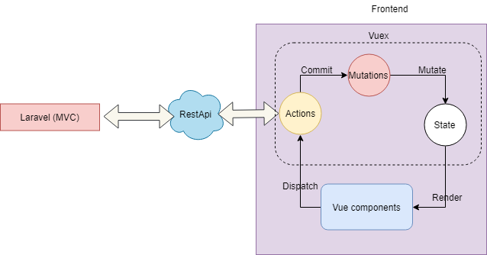
Implementation
Architecture
21
Notes:
Commençant par le backend des deux applications où nous avons utilisé le modèle de conception du contrôleur de vue de modèle pour créer nos API
Ensuite, nous avons le front-office qui était basé sur le modèle de modèle vue vue,
Et pour le Backoffice, nous avons utilisé le présentateur de la vue Modèle.
Les trois modèles facilitent grandement le travail et la création d'un code organisé

Slide 22






Implementation
Used technology
Laravel
VueX
state management pattern
JavaScript UI library
Android
2011
Most used
Open source
Multitasking
Play store
Android notification
centralized store for all the components in an application
Flexible and easy to use
PHP framework
VueJS
best libraries for every feature
MVVM
The view, the state and the actions
Swagger
Single-Page Applications
Vuetify
Templates for various frameworks
Internationalization
SSR and PWA
API documentation
Size, performance, learning curve, etc.
maintaining the synchronization in APIs and its documentation
22
Notes:
**I will be presenting some of the most important technologies that were used in this work starting by Laravel .
Swagger was also use for the documentation of the APIs.
**Vuejs was actually a life saver at this point, SSR: Server side rendering PWA:Progressive web app
**And for the mobile application we used Android

Slide 23


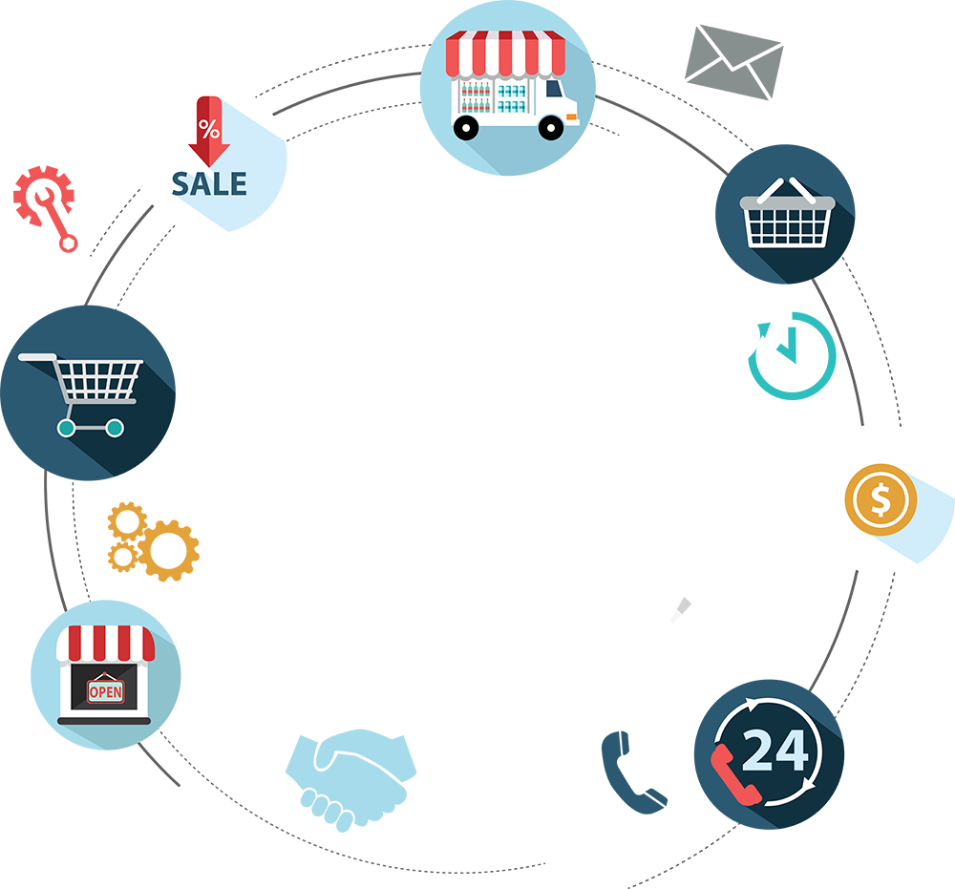
Implementation
Demo
23
Notes:
For the demonstration I will be presenting a video of the most important scenarios.

Slide 24
Conclusion
Notes:
Last but not least the conclusion

Slide 25


Conclusion & perspectives
Web
Mobile
Professional experience
Team work
Personal orders
3D order
Online payment
25
Notes:
On a presente la problématique et la solution, en donnant toutes les besoins fonc et non-fonc et la conception, mais j'ai également présenté l'application en donnant les technologies utilisées telles que Laravel, Vuejs, Android, etc.,
Cependant, le travail ne doit pas s'arrêter là. En tant que perspective que je voudrais offrir, le client peut effectuer sa commande personnelle, il peut créer un produit 3 d et il peut également payer en ligne.

Slide 26

THANK YOU
for your attention
Notes:
Thank you for your attention, I will be happy to answer any questions

